Slide 1
WARNING
These slides are not optimized for printing or exam preparation. These are for lecture delivery only.
These slides are made for PowerPoint 2010. They may not show up well on other PowerPoint versions. You can download PowerPoint 2010 viewer from here.
These slides contain a lot of animations. For optimal results, watch in slideshow mode.

Slide 2

Scenario: Developing software

Slide 3
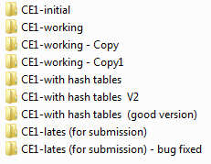

Optimize
Initial code
Better hash
Optimize
Fix bug
OOPS!!!
Format output
Hash table
Fix bug

Slide 4

[managing multiple versions of a piece of information]
Revision Control
Doesn’t waste space?
Can go back to any previous point?
Can tell what changed from one version to the next?
Can record your explanations for each change?
OOPS!!!

Slide 5
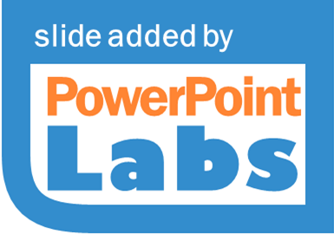
[managing multiple versions of a piece of information]
Revision Control
Only one copy (doesn’t waste space)
Can go back to any previous point
Can tell how content changed from one version to the next
Can record your explanations for each change
OOPS!!!

Slide 6
Introduction to
Your own private time machine
Revision Control

Slide 7



Revision Control Software
ABC Drink
Apple
Beetroot
043703f2
Carrot
8e5b3dab
Repo
5f5c5e5b
(Repository)

Slide 8


Revision Control Software
Git + more
Repo
Clone
Repo
Repo
Repo
(Repository)
Pull
Push

Slide 9

Repo on GitHub
Forked repo on GitHub
1. fork
3. update, stage, commit
4. push
2. clone
Local repo
Local repo
Owner
Contri-butor

Slide 10
[managing multiple versions of a piece of information]
Revision Control

Slide 11

Your journey towards production quality code using industry-strength tools starts today!

Slide 12



Prime Your Primary Weapon: Introducing IDEs

Slide 13
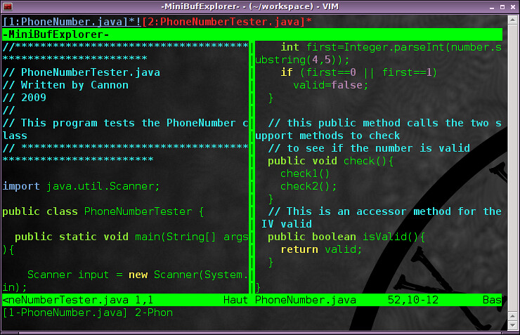
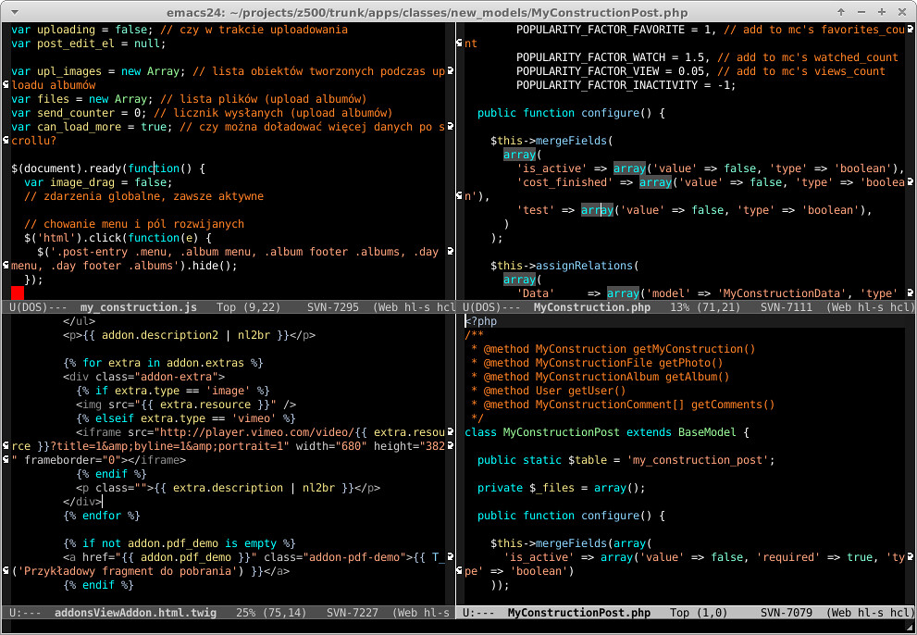
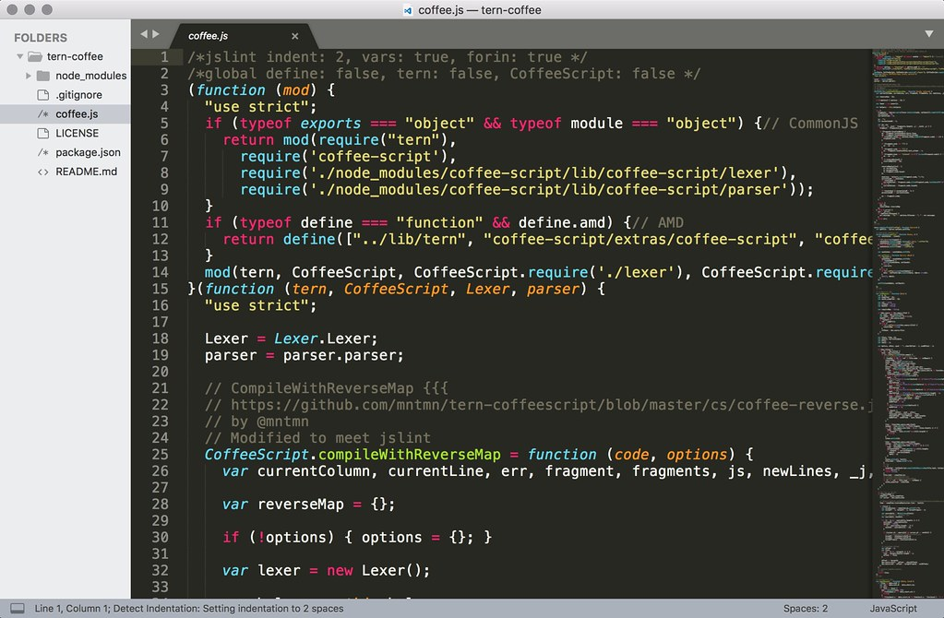

Slide 14
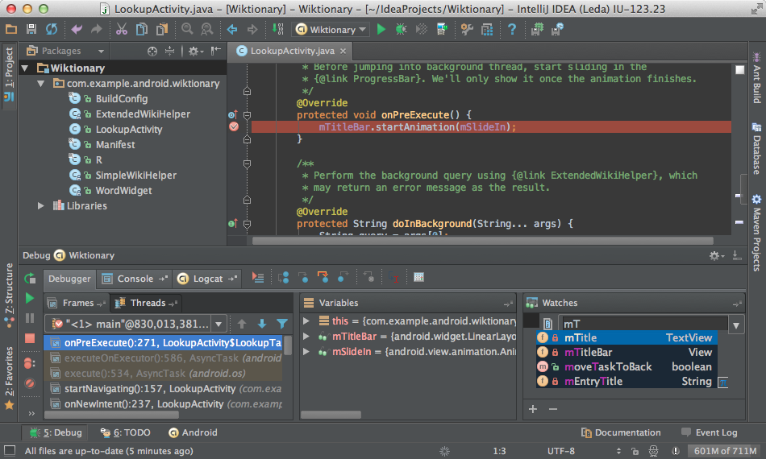
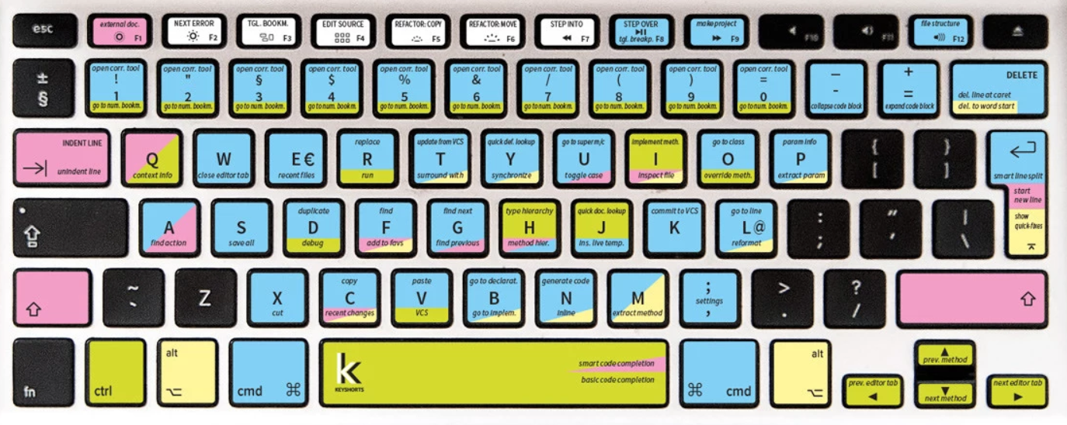
Integrated Development Environments (IDEs)

Slide 15

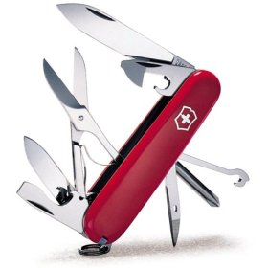
It’s your primary weapon. Soon: Learn basics first

Slide 16
